Slide 1
KHÓA ĐÀO TẠO NGUYÊN TẮC GIAO DỊCH VÀ PHÁT TRIỂN SỞ GIAO DỊCH HÀNG HÓA GIAO SAU
 | Bộ Công Thương Vụ Pháp chế
TP. Hồ Chí Minh, ngày 22-24 tháng 12 năm 2014

Slide 2
Lạm dụng thị trường, thao túng, vi phạm trong môi giới
Các ví dụ trong lịch sử

Slide 3
Lạm dụng thị trường – hành vi cẩu thả đối với nhà môi giới
Hứa hẹn lợi nhuận nhiều
Đầu tư lừa bịp – chài kéo các quỹ mới để chi trả cho các khách hàng củ
Làm giả hồ sơ
Giao dịch phỗng tay trên (Front-running) – giao dịch cho bản thân trước các giao dịch của khách hàng
Đánh lừa (Spoofing) – Đặt lệnh mua và bán và ngay lập tức hủy bỏ các lệnh này
Bắt cá nhiều tay (Churning) – thực hiện nhiều giao dịch cho khách hàng nhằm kiếm nhiều phí giao dịch.
Mua bán vào giờ cuối (Marking the close) – thực hiện nhiều lệnh lớn để mua hoặc bán với ý định làm ảnh hưởng lên giá đóng cửa.
Notes:
DEFINITION OF 'FRONT RUNNING'
The unethical practice of a broker trading an equity based on information from the analyst department before his or her clients have been given the information.
Spoofing
Definition
Stock market manipulation in which a trader with a position in a stock places an anonymous buy order for a large number of shares through an ECN and then cancels it seconds later. The price of the stock will immediately jump, giving the impression of high demand, which draws others into buying the stock, allowing the manipulator to sell at a higher price. Some market analysts believe this is one cause of increased volatility in the markets.
Churning
Excessive trading in a client's account by a broker seeking to maximize commissions regardless of the client's best interests, in violation of NASD rules. also called twisting or overtrading Read more: http://www.investorwords.com/856/churning.html#ixzz3Lq8LBGOv
Marking the close is the practice of buying a security at the very end of the trading day at a significantly higher price than the current price of the security. The purpose of the practice of marking the close is to raise the closing price of the security, making it appear to be higher-valued than it actually is.
The following is an example of a case law referring to marking the close:
Marking the close is the practice of placing late-day orders to raise the reported closing price of the stock. [SEC v. Competitive Techs., Inc., 2005 U.S. Dist. LEXIS 43349 (D. Conn. July 21, 2005)].

Slide 4
Thao túng thị trường – bóp méo thị trường thực để kiếm lời từ giao dịch giao sau
Tích trữ một lượng lớn hàng thực của một hàng hóa để gây cho giá giao sau tăng lên.
Vận chuyển một lượng lớn hàng hóa thực để gây thiếu hụt hoặc dư thừa trên thị trường giao hàng.
Làm giả hồ sơ cung ứng hàng thật để tạo bề ngoài về sự thiếu hụt hoặc dư thừa trên thị trường giao hàng.

Slide 5
Những ví dụ thật về thao túng/lạm dụng thị trường
Peregrine – tạo lập báo cáo ngân hàng giả mạo.
MFGlobal – dùng tiền của khách hàng để tái thanh toán cho chủ nợ.
Armajaro – tạo ra góc khuất thị trường cocoa bằng cách nhận nhiều hàng giao cho một hợp đồng.
Ferruzzi – tạo ra góc khuất thị trường bằng cách tích trữ đậu nành.
Tino deAngelis – tạo lập các hồ sơ giả mạo về dầu đậu nành chứa ở các thùng đựng trong kho.
Notes:
In finance, to corner the market is to get sufficient control of a particular stock, commodity, or other asset to allow the price to bemanipulated. Another definition: "To have the greatest market share in a particular industry without having a monopoly. Companies that have cornered their markets usually have greater leeway in their decisions; for example, they may charge higher prices for their products without fear of losing too much business. Large companies, such as Wal-Mart or Microsoft, are considered to have cornered their markets."^{[1]} In either case, the cornerer hopes to gain control of enough of the supply of the commodity to be able to set the price for it.
This can be done through several mechanisms. The most direct strategy is to simply buy up a large percentage of the available commodity offered for sale in some spot market and hoard it. With the advent of futures trading, a cornerer may buy a large number offutures contracts on a commodity and then sell them at a profit after inflating the price.
Although there have been many attempts to corner markets by massive purchases in everything from tin to cattle, to date very few of these attempts have ever succeeded; instead, most of these attempted corners have tended to break themselves spontaneously. Indeed, as long ago as 1923, Edwin Lefèvre wrote, "very few of the great corners were profitable to the engineers of them."^{[2]} A cornerer can become vulnerable due to the size of the position, especially if the attempt becomes widely known. If the rest of the market senses weakness, it may resist any attempt to artificially drive the market any further by actively taking opposing positions. If the price starts to move against the cornerer, any attempt by the cornerer to sell would likely cause the price to drop substantially. In such a situation, many other parties could profit from the cornerer's need to unwind the position.

Slide 6
Gian lận tài chính - Peregrine nhà môi giới 2012
Giả mạo hồ sơ ngân hàng trong 20 năm –
Ăn cắp US $200 triệu tiền của khách hàng để tiêu dùng riêng
Thừa nhận biển thủ
Ngồi tù 50 năm
Không một cơ quan quản lý nào đã từng kiểm tra với ngân hàng để thẩm tra hồ sơ – bao gồm cả CFTC, CME, NFA

Slide 7
Gian lận tài chính - MFGlobal 2011
Giám đốc điều hành MFG cá cược với tài sản lớn lên nợ phát hành trái phiếu châu Âu – trái phiếu Ý/ Tây ban Nha
Thất thoát gia tăng
MFG không thể trả nợ cho các chủ nợ
MFG sử dụng US$ 1.6 bn tiền quỹ của khách hàng ở các tài khoản cách ly để trả tiền cho JPMorgan London
Nộp đơn xin phá sản
Tiền cuối cùng được hoàn trả lại cho khách hàng
CFTC vẫn đang điều tra
Notes:
DEFINITION OF 'SOVEREIGN DEBT'
Bonds issued by a national government in a foreign currency, in order to finance the issuing country's growth. Sovereign debt is generally a riskier investment when it comes from a developing country, and a safer investment when it comes from a developed country. The stability of the issuing government is an important factor to consider, when assessing the risk of investing in sovereign debt, and sovereign credit ratings help investors weigh this risk.

Slide 8
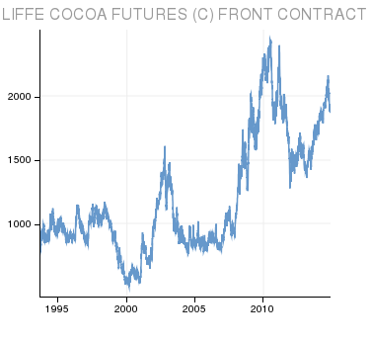
Armajaro – lũng đoạn cocoa năm 2010
Armajaro mua trên 22,000 Tháng 7 cocoa giao sau trên sở giao dịch London vào đầu năm 2010
Vào tháng 7, giá cocoa tăng cao
Giá cao làm cho việc vận chuyển cocoa chuyển từ New York sang châu Âu
Sau khi nhận 240,000 MT, giá sụt giảm
Các nhà buôn Cocoa yêu cầu giám sát sàn giao dịch nhiều hơn
Nay Sở giao dịch áp đặt giới hạn vị thế 7500 cho các hợp đồng

Slide 9
Ferruzzi – lũng đoạn đậu nành năm 1989
Người khổng lồ nông nghiệp nắm giữ vị thế mua lớn về đậu nành giao sau ở Chicago Board of Trade.
Các vị thế giao sau này trở thành vị thế thực lớn tại các kho giao hàng ở Chicago/Toledo khi Ferruzzi nhận hàng cho các hợp đồng vào Tháng 1 và Tháng 3/1989.
Tháng 5/1989, Ferruzzi sở hữu hầu như tất đậu nành ở thị trường giao hàng Chicago/Toledo.
Cả hai CBOT và CFTC kết luận rằng Ferruzzi đã thao túng thị trường bằng cách lũng đoạn nguồn cung hàng hóa.

Slide 10
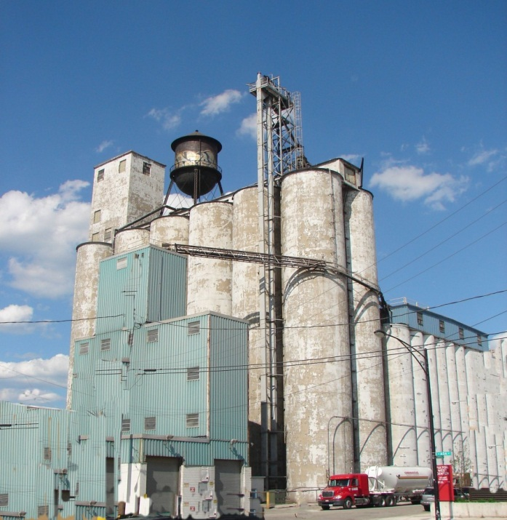
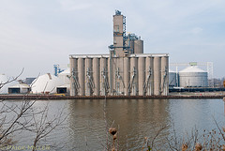

Slide 11
Ferruzzi – lũng đoạn đậu nành năm 1989
CFTC quyết định thu hồi trạng thái phòng hộ rủi ro của Ferruzzi, điều này có nghĩa sẽ không tích tụ đậu nành được thông qua thị trường giao hàng.
Tháng 7/1989, CBOT ban hành qui định “thanh lý” đậu nành Tháng 7.
Giá sụt giảm 25% trong 2 tuần.
1992 Ferruzzi trả US$ 1,6 triệu tiền phạt và từ bỏ CBOT.
1993 Ferruzzi nộp đơn xin phá sản.

Slide 12
Tino deAngelis – nhà buôn dầu đậu nành năm 1936
Thuê kho để tồn trữ dầu đậu nành
Mua 1,9 tỷ dầu đậu nành giao sau – giả định là Hoa kỳ sẽ mua số lượng lớn dầu để tặng cho Nga
Báo cáo một lượng lớn tồn trữ dầu đậu nành
Đổ trong các thùng chứa là phần lớn nước
Giá dầu đậu nành sụt giảm khi việc tặng dầu cho Nga không diễn ra
oil
water
Notes:
Leased 139 silos to hold soybean oil
Obtained loans based on full silo tanks
In reality, tanks were filled with water with oil floating on top

Slide 13
Bài học
Các qui định nghiêm ngặt về việc xử lý tiền của khách hàng.
Thông tin tài khoản ngân hàng cần thẩm định độc lập.
Tồn kho thực và giá cả của chúng phải được giám sát.
Việc sở hữu nhiều hợp đồng giao sau – cần ngăn ngừa bằng các đưa ra các chính sách đúng.
Lạm dụng thị trường và thao túng thị trường tiêu diệt lòng tin vào thị trường và các nhà giám sát thị trường.

Slide 14
Liên hệ:
Ban quản lý Dự án EU-MUTRAP
Phòng 1203, Tầng 12, Khu Văn phòng, Tòa tháp Hà Nội,
49 Hai Bà Trưng, Hoàn Kiếm, Hà Nội
Tel: (84 - 4) 3937 8472
Fax: (84 - 4) 3937 8476
Email: mutrap@mutrap.org.vn
Website: www.mutrap.org.vn
(Tài liệu đào tạo được đăng trên trang Web này)

